Slide 1




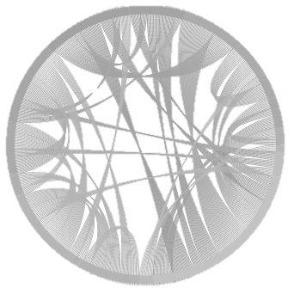

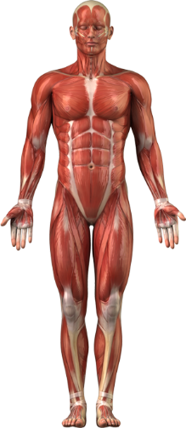






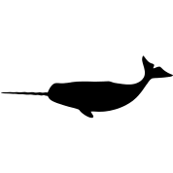


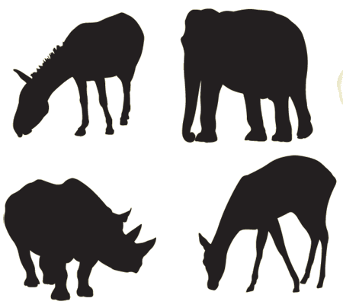




Comparative Mammalian Proteome Aggregator Resource (CoMPARe) Program

Slide 2
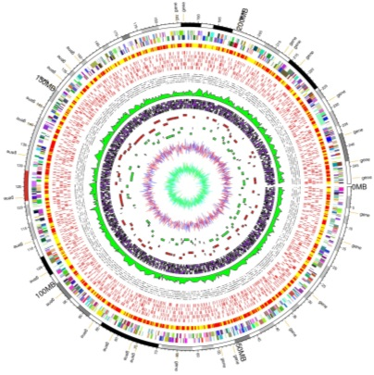
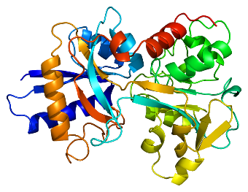
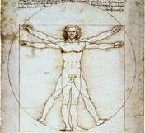
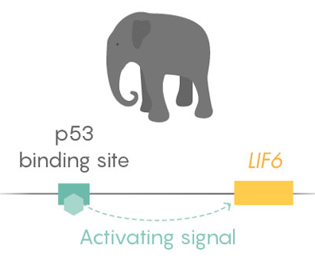


Comparative Medicine – using animal models to study human disease (NIH)
Biomimicry – understanding traits to drive technology and improve human health
Comparative Proteomics – studying differences in proteomes across species with a biomimicry focus
Genome
Transcriptome
Proteome
Phenotype
Gene
mRNA
Protein
Gene copy or mRNA abundance does not correspond to protein abundance/activity
Evolutionary pressure is at the phenotype level, which is directly controlled at the protein level.
Public
Notes:
Billions of years to evolve millions of species which have adapted to diverse physiological niche using different molecular solutions.
Elephant example
Have a 5% cancer rate as opposed to around 25% in humans
Genome has many more copies of p53, but a paper last year found it was that these p53 were turning on this gene thought to be non-coding. Point is that it is difficult to predict from genome, and gene copy number or transcript copies don’t equal protein abundance/activity.

Slide 3
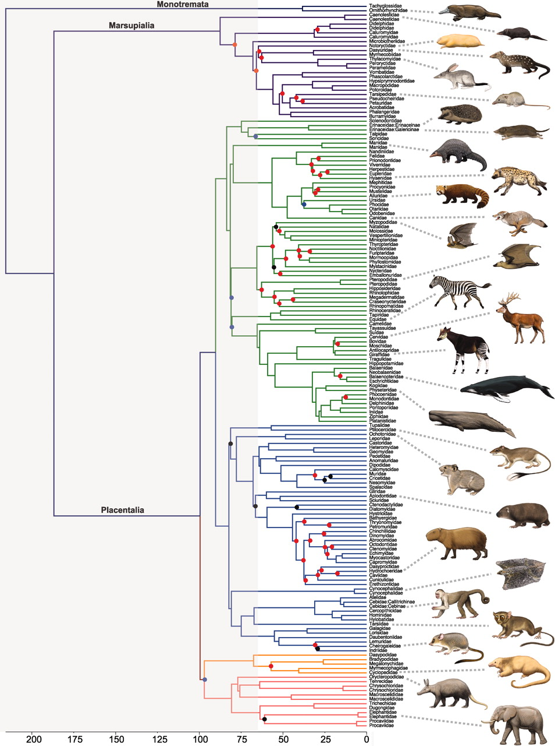
Comparative Proteomics
Diving Mammals
Hold breath for hours while diving miles underwater
How do they avoid ischemia/reperfusion?
Vampire Bats
high intake of proteins causes azotaemia (high serum urea levels)
how are kidneys protected against protein overload?
Hibernating Mammals
Effectively shutdown metabolically
How do they avoid uremia and thrombotic complications?
Robert W. Meredith et al. Science 2011;334:521-524

Slide 4
Comparative Proteomics
Genomes (117)
Blood Proteomes
dog
cow
dolphin
rat
mouse
human
primates
Robert W. Meredith et al. Science 2011;334:521-524

Slide 5
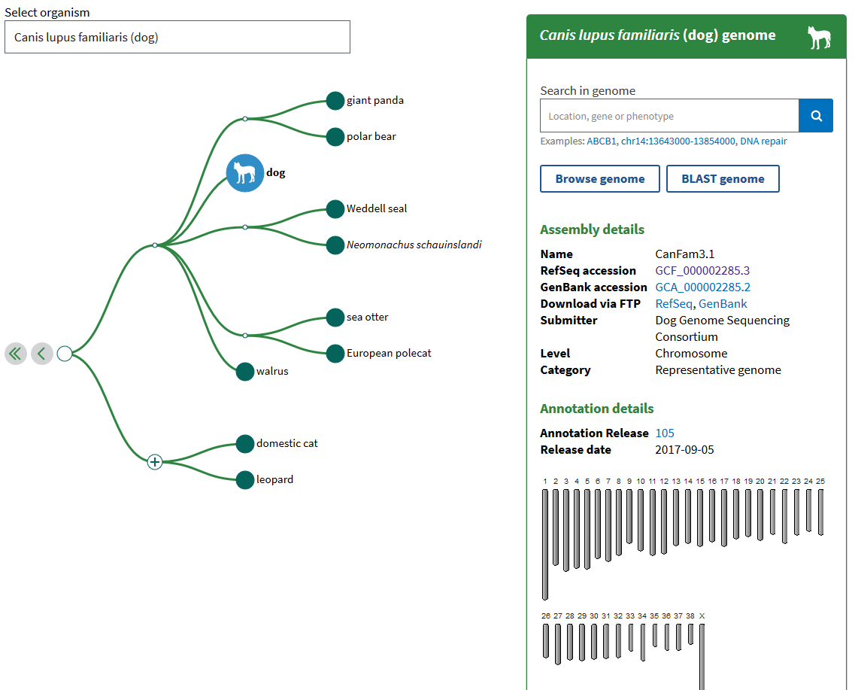
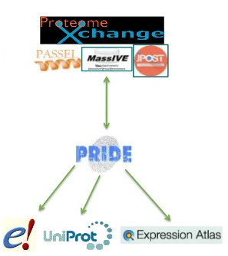
Comparative Mammalian Proteome Aggregator Resource (CoMPARe) Program
Acquire proteomic data across mammalian species
Develop a portal for stakeholders to access and explore results (constant updates)
Enable researchers to mine high-quality proteomic data from phylogenetically diverse species to identify advantageous biological adaptations
Drive human biomedical breakthroughs
Public

Slide 6
ComPARe Phase 1 – 30 species
Genomes
Blood Proteomes*
koala
Amur tiger
African leopard
Cheetah
dog
vampire bat
flying fox bat
Polar bear
sheep
pig
camel
cow
bison
dolphin
beluga
porpoise
hyrax
rat
mouse
bonobo
orangutan
western lowland gorilla
human
Robert W. Meredith et al. Science 2011;334:521-524
*not all listed
Notes:
Will continue to add species (with more genomes) and samples, and also branch to other fluids and tissues.

Slide 7









Why NIST?
Partners for high-quality samples and expert insight/analysis:
High-quality genomic and transcriptomic sequencing as needed (alongside JIMB and Bioassay Methods Group)
NIST standard processing and acquisition protocols on cutting-edge instrumentation
People have studied these species, but not as many at once, nor with standardized methods
Mission to mange the data into easily accessible and usable product
Data and developed bioinformatics tools have impact beyond biomimicry
Generating the data, tools and applications allows us to become knowledge brokers to facilitate biomimetic discoveries and accelerate biomedical advances
Public

Slide 8


